Slide 1
Home/Dashboard
Login
Welcome User
Search
Pay Fines
Admin
Search
Login
Register
Books Borrowed
BookA | Due Date | [extend]
Book B| Due Date | [extend]
Book C| Due Date | no extension
Book D| Due Date | [extend]
Register
Books Reserved
BookA | expected date | [cancel]
Book B
Book C
Book D
Fines Outstanding:
$100
Register
Pay Fines

Slide 2
Pay Fines
Welcome User
Payment Confirmed dialog
(new window)
Your Fines
Fine From | Amt
01/2021| $15
Day 17 | $19
Total: $100
Thanks for paying the Fine of $[total_fine];
You may now continue to borrow/reserve more books
Ok
Pay Fines
Cancel
Back to homepage
Backend:
Record [user] pays [total_fine]

Slide 3
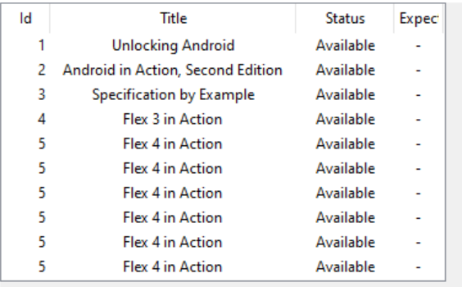
Search display
Welcome User
Confirm Borrow
Search
Pay Fines
Confirm Borrow [book_title]?
Search
Advanced search settings
BookID | Title | availability | expected due date |
BookID | Title | available | - | [borrow]
BookID | Title | loaned | dd/mm/yy | [reserve]
BookID | Title | reserved | dd/mm/yy | [-]
BookID | Title | reserved | dd/mm/yy | [-]
BookID | Title | reserved | dd/mm/yy | [-]
Backend:
Record [user] pays [total_fine]
BookTitle
Borrow
This book is a book about Java and Object Oriented Programming
Reserve
ISBN: 5555555555

Slide 4
Search with Advacned Searchdisplay
Welcome User
Confirm Borrow
Confirm Borrow [book_title]?
Search
BookID | Title | availability | expected due date |
BookID | Title | available | - | [borrow]
BookID | Title | loaned | dd/mm/yy | [reserve]
BookID | Title | reserved | dd/mm/yy | [-]
BookID | Title | reserved | dd/mm/yy | [-]
BookID | Title | reserved | dd/mm/yy | [-]
Backend:
Record [user] pays [total_fine]
BookTitle
Borrow
This book is a book about Java and Object Oriented Programming
Reserve
ISBN: 5555555555

Slide 5
Admin Pane
Welcome Admin
Confirm Borrow
Confirm Borrow [book_title]?
View all borrowed books
View all reserved books
Backend:
Record [user] pays [total_fine]
View all users with unpaid fines

